Slide 1
3D INDOOR NAVIGATION
USING DEPTH ORDERING
Painter’s Algorithm | Depth-Sorting Algorithm | Back-to-Front Rendering
PRESENTED BY
PUNEETH N • 2411021061259
Topic 28 | Computer Graphics Micro Project

Slide 2
1. Objective & Project Outcome
What the micro project demonstrates
OBJECTIVE
OUTCOME
Implement depth ordering for objects in a 3D indoor navigation environment so that overlapping surfaces render correctly.
A working indoor environment where walls, desks and other surfaces appear in the correct front-to-back order.
Core idea: farther first → nearer last
2

Slide 3
2. What Is Painter’s Algorithm?
Also called depth sorting or back-to-front rendering
THE BASIC IDEA
OTHER NAMES
Render polygons in order from the farthest object to the nearest object.
Depth-Sorting Algorithm
Back-to-Front Rendering
• Nearer polygons are drawn later.
• Later drawing covers earlier drawing.
• This creates the correct visual overlap.
Priority Fill
3

Slide 4
3. How It Works
Four steps are performed every frame
01
02
03
04
Transform
Measure Depth
Sort
Draw
→
→
→
Convert each polygon into camera space.
Find distance from camera to polygon centre.
Order polygons from farthest to nearest.
Paint in that sorted order.
4

Slide 5
4. Measuring Depth
The project uses the face centre as the sorting reference
face_depth(face, cam)
DISTANCE
The four polygon corners are averaged to find the face centre.
d = √(x² + y² + z²)
Larger distance = farther polygon
Smaller distance = nearer polygon
The vector from the face centre to the camera is converted to a straight-line distance.
5

Slide 6
5. Sorting & Drawing
Far-to-near ordering controls visibility
SORT
DRAW
painter_sort(items)
FAR → MID → NEAR
The project sorts by distance using reverse=True, placing the farthest polygon first and the nearest last.
Each polygon is painted over what is already on the screen. Therefore, nearer surfaces cover farther surfaces.
6

Slide 7
6. 3D Indoor Navigation Environment
Features included in the running project
✓ 4 rooms + corridor
✓ Near-plane clipping
✓ Hinged doors that open when you approach
✓ Distance fog
✓ Walls split into 1.5 m tiles for better sorting
✓ Collision detection
✓ Back-face culling
✓ Live depth labels + minimap
7

Slide 8
7. Demonstrating Correct Rendering
The strongest proof is the P ON / P OFF comparison
P ON — CORRECT
P OFF — WRONG
DEPTH VIEW — G
Walls and desks correctly hide objects behind them.
Far objects can be painted over nearer objects.
Near objects are brighter; far objects are darker.
Press P to switch the Painter’s Algorithm on/off.
8

Slide 9
8. Limitations & Z-Buffer
Why another visibility method is commonly used
PAINTER’S ALGORITHM — LIMITATIONS
Z-BUFFER
• Cyclic or intersecting polygons can break the order.
• Sorting costs O(n log n) per frame.
• Hidden polygons are still painted, causing overdraw.
• Stores depth for every pixel.
• Does not require polygon sorting.
• Uses additional memory.
9

Slide 10
9. Controls & Live Demonstration
Use these controls while presenting
W A S D / Arrows
Move
Q / E / Mouse drag
Turn
P
Painter’s Algorithm ON / OFF
G
Depth shading
L
Object depth labels
- / =
Replay draw order
10

Slide 11
10. Conclusion
What the micro project demonstrates
KEY TAKEAWAY
Painter’s Algorithm renders a scene by sorting polygons from farthest to nearest, allowing nearer surfaces to cover farther ones.
The project demonstrates this process in a 3D indoor navigation environment and shows both its practical benefits and limitations.
11

Slide 12
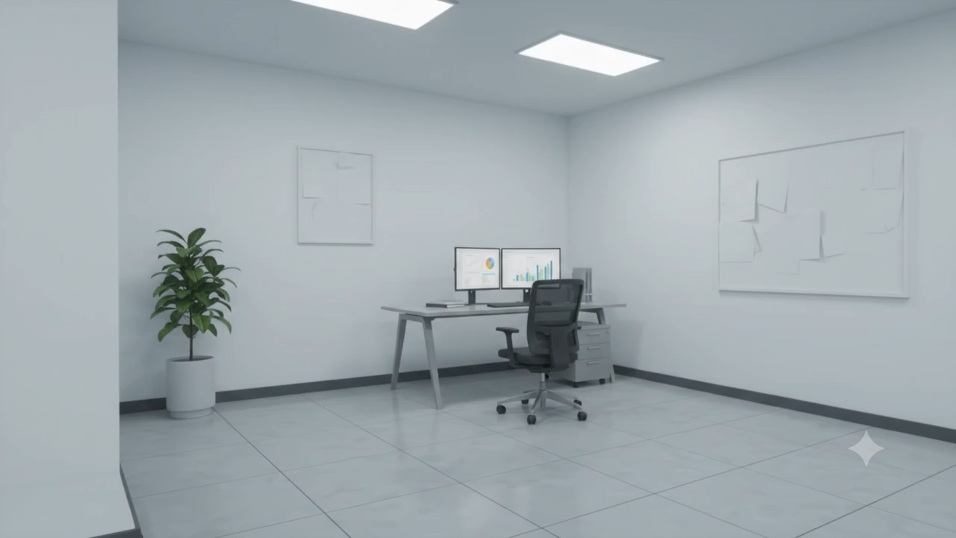
11. PROJECT VIDEO
Project Example Using Video:
VIDEO PLACEHOLDER
Add your running-project video on this slide
Do not add other content — keep this slide dedicated to the demo.
12

